Slide 1



Job Application MARKET
Sajan, Neelima, SANDHYA, PAVAN

Slide 2

Goals of the PROJECT
Is there a significant difference between the proportion of males vs nonmales who are employed given their degree in higher education?
Is there a difference in the average number of computer skills acquired based on level of education?
Is age a significant factor in determining whether an individual is a professional developer or not?
Is status mental health associated with a programmer’s previous salary?

Slide 3

Exploratory Data Analysis
Plots depicting the data characteristics
Mention how we defined the data and how we cleaned it
We'll also want the descriptions of the data variables here

Slide 4



Slide 5
Hypothesis Testing
Is there a significant difference between the proportion of males vs nonmales who are employed given their degree in higher education?

Slide 6
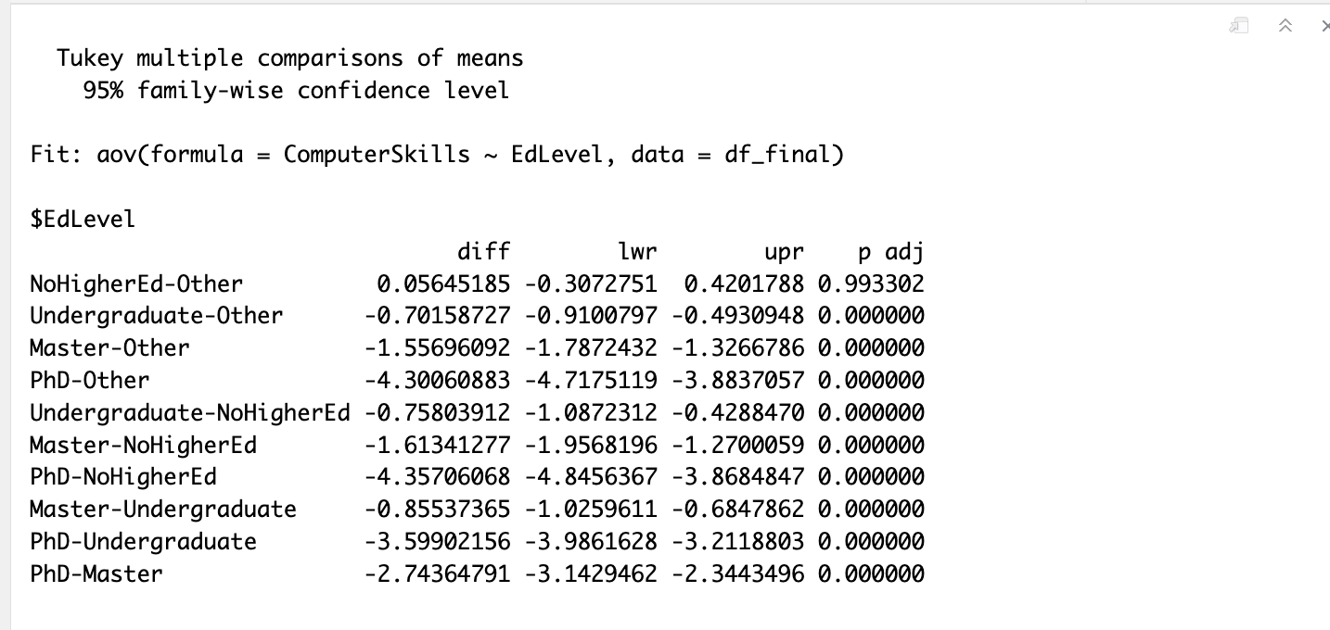
Hypothesis Testing
Is there a difference in the average number of computer skills acquired based on level of education?
**Students with Undergraduate, Master, or PhD degrees had lower computer skills than the 'Other' group, with noticeable differences backed by data.**

Slide 7
Hypothesis Testing
Is age a significant factor in determining whether an individual is a professional developer or not?

Slide 8
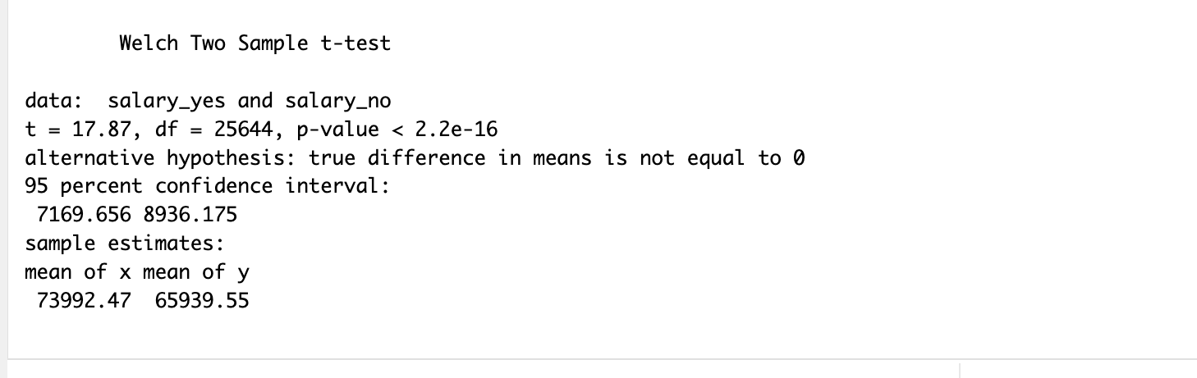
Hypothesis Testing
Is status of mental health associated with a programmer’s previous salary?
**people who said "Yes" to mental health issues earn about $7,993 to $8,936 more than those who said "No”*

Slide 9

CONCLUSIONS
We will put conclusions here.

Slide 10
LIMITATIONS
Biases: Data is from Stack Overflow, so it's tech-focused.
Human error: Mistakes in the data can affect the study's results.
Categorization: Some features have lots of categories, complicating analysis.
Age: We don’t know in depth details of age(only under/above 35).
Data loss in cleaning: May lack key factors such as connections and accuracy.

Slide 11

FURTHER RESEARCH
DEEPEN ANALYSIS: Dive deeper into specific categories, like age or country, for more detailed insights.
Predictive Modeling: Use the data to create models predicting employability, refining them as we gather more insights.
Feedback: UTILIZE THE FEEDBACK GIVEN BY THE PROFESSOR/PEER to GUIDE OUR NEXT STEPS Final project.

Slide 12

COMMENTS / QUESTIONS?
This Photo by Unknown Author is licensed under CC BY-SA

